Slide 1
Analysis Involving Collation of Data Science Algorithms
ANKUR YADAV
ADITYA TARI
NAVJEET PATTALI

Slide 2

1. Introduction
Because of new computing technologies, machine learning today is not like machine learning of the past. It was born from pattern recognition and the theory that computers can learn without being programmed to perform specific tasks;
Researchers interested in artificial intelligence wanted to see if computers could learn from data. The iterative aspect of machine learning is important because as models are exposed to new data, they are able to independently adapt. They learn from previous computations to produce reliable, repeatable decisions and results.
Machine learning presents many of the same challenges as otheranalytic methods; it also presents some unique challenges primarily related tocomplicated and opaque modeling algorithms.
Notes:
tari-1to8
ankur-9to14
navjeet-15to25

Slide 3
1.1 Introduction To Project
Learning from data is of interest to many disparate fields such as banking, bioinformatics, business, computer vision and education. The field of data mining uses a large collection of machine learning algorithms whose goal is to extract useful information from collected data.
For any given dataset, a common question is which learning algorithm is best suited for it.
Performing experiments with several algorithms using the data, orgetting advice from machine learning experts, can help assess which algorithms might be the best candidates, but this is not always practical
Using the idea of meta-learning, we solve the problem of selecting a machine learning algorithm for a particular dataset.
In this work, we represent the efficient way to deal with a non-standard format in real-world dataset to obtain training data.
Notes:
Notes to presenter:
Description of what you learned in your own words on one side.
Include information about the topic
Details about the topic will also be helpful here.
Tell the story of your learning experience. Just like a story there should always be a beginning, middle and an end.
On the other side, you can add a graphic that provides evidence of what you learned.
Feel free to use more than one slide to reflect upon your process. It also helps to add some video of your process.

Slide 4
1.2 What is necessary for good machine learning algorithm?
Data preparation capabilities.
Algorithms – basic and advanced.
Automation and iterative processes.
Scalability.
Ensemble modeling.
Notes:
Notes to presenter:
Description of what you learned in your own words on one side.
Include information about the topic
Details about the topic will also be helpful here.
Tell the story of your learning experience. Just like a story there should always be a beginning, middle and an end.
On the other side, you can add a graphic that provides evidence of what you learned.
Feel free to use more than one slide to reflect upon your process. It also helps to add some video of your process.

Slide 5

1.3 Types of ML Problems There are several subclasses of ML problem based on what the prediction task looks like.
Type of ML Problem | Description | Example
Classification | Pick one of N labels | Cat, dog, horse, or bear
Regression | Predict numerical values | Click-through rate
Clustering | Group similar examples | Most relevant documents (unsupervised)
Association rule learning | Infer likely association patterns in data | If you buy hamburger buns, you're likely to buy hamburgers (unsupervised)
Structured output | Create complex output | Natural language parse trees, image recognition bounding boxes
Ranking | Identify position on a scale or status | Search result ranking

Slide 6
1.4 Proposed Idea
When you look at machine learning algorithms, there is no one solution or one approach that fits all.
There are several factors that can affect your decision to choose a machine learning algorithm
Some problems are very specific and require a unique approach.E.g Recommender System
While some other problems are very open and need a trial & error approach.
Supervised learning,classification and regression etc. are very open. They could be used in anomaly detection, or they could be used to build more general sorts of predictive models.

Slide 7
Problem Statement
When you work on a machine learning project ,common task is to search for the most appropriate algorithm(s)to retrieve important information from data. With an increasing number of available data mining techniques, it may be impractical to experiment with many techniques on a specificdataset of interest to find the best algorithm(s).
Notes:
Notes to presenter:
What is your purpose for sharing this reflection?
Is it at the end of a unit or project?
Are you sharing this reflection, at the attainment of a learning goal you set for yourself?
Is it at the end of a course?
State your purpose for the reflection or even the purpose of the learning experience or learning goal. Be clear and be specific in stating your purpose.

Slide 8
3.Project Objectives / Idea
In performing data mining, a common task is to search for the most appropriate algorithm(s)to retrieve important information from data. With an increasing number of available datamining techniques, it may be impractical to experiment with many techniques on a specificdataset of interest to find the best algorithm(s).
Our approach involves the following steps:
Create a training set from original datasets and evaluate performance of algorithm onthese transformed datasets.
Select a good model with best performance on test dataset.
Generate a ranked list of machine learning algorithms using performance measures.We then present statistical summary of the comparisons carried out

Slide 9

6. What are our steps?
Select Problem Domain & Dataset
4
Train Model for dataset
3
2
Evaluate Models
1
Suggest Suitable Model
Notes:
Notes to presenter:
What steps will you be taking as a result of this learning experience?
Did you learn from any failed experiences? How will you do things differently?
What advice will you give to others so they can learn from your experiences?
How can you share what you learned with a real-world audience?
Some examples of next steps might be:
After delivering my first persuasive presentation, I am thinking about joining the debate team.
After making my first film, I’m considering entering it in our school film festival or local film festival.
After connecting with this career expert, I’d like to do some research on that career field because it sounds interesting to me.
This SmartArt allows you add images and text to help outline your process. If a picture is worth a thousand words, then pictures and words should help you communicate this reflection on learning perfectly! You can always click on Insert>SmartArt to change this graphic or select the graphic and click on the Design contextual menu to change the colors.
Feel free to use more than one slide to share your next steps. It also helps to add some video content to explain your message.

Slide 10
4. Approach
Machine learning is part art and part science. When you look at machine learning algorithms, there is no one solution or one approach that fits all. There are several factors that can affect your decision to choose a machine learning algorithm.
Some problems are very specific and require a unique approach.
While some other problems are very open and need a trial & error approach.

Slide 11
4.1 Approach to Project
Categorize the problem:
1) Categorize by input:
•If you have labelled data, it’s a supervised learning problem.
•If you have unlabelled data and want to find structure, it’s an unsupervised learning problem.
•If you want to optimize an objective function by interacting with an environment, it’s a reinforcement learning problem
2) Categorize by output.
•If the output of your model is a number, it’s a regression problem.
•If the output of your model is a class, it’s a classification problem.
•If the output of your model is a set of input groups, it’s a clustering problem.
•Do you want to detect an anomaly ? That’s anomaly detection

Slide 12
4.2 Prerequisites Before Choosing the Algorithms
Clean data
Dealing with missing data
Choose what to do with outliers
Aggregate the data that needs to be aggregated.
Augment Data
1) Feature engineering is the process of going from raw data to data that is ready for modeling. It can serve multiple purposes:
Make the models easier to interpret (e.g. binning)
Capture more complex relationships (e.g. NNs)
Reduce data redundancy and dimensionality (e.g. PCA)
Rescale variables (e.g. standardizing or normalizing)
2) Different models may have different feature engineering requirements. Some have built in feature engineering

Slide 13
4.3 Algorithms
Understand your constraints:
What is your data storage capacity?
Does the prediction have to be fast?
Does the learning have to be fast?
Than we compare the performance of different algorithms for a specific problem on the same data-set. Here, we discuss the reasons to use algorithms for different applications.
We also present numerical results with comparisons.
This study will help people in deciding the most suitable algorithm for their application and provide a solution.

Slide 14
4.4 METRICS
Each machine learning model is trying to solve a problem with a different objective using a different dataset and hence, it is important to understand the context before choosing a metric.
Regression Metrics:
Mean Squared Error (MSE)
Root Mean Squared Error (RMSE)
Mean Absolute Error (MAE)
R Squared (R²)

Slide 15
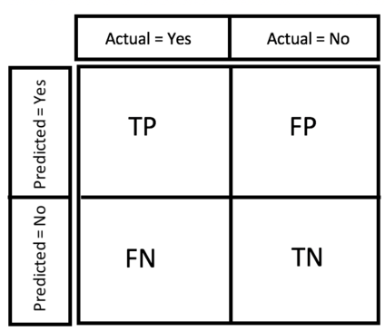
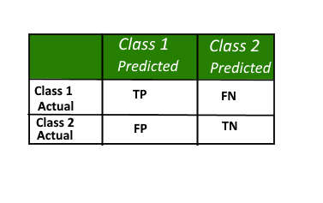
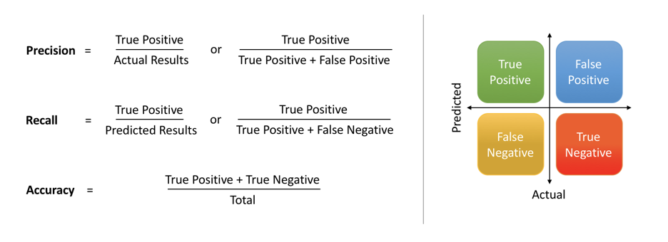
Confusion Matrix
Precision &Recall
R² Metric
The R^2 (or R Squared) metric provides an indication of the goodness of fit of a set of predictions to the actual values. In statistical literature, this measure is called the coefficient of determination.
This is a value between 0 and 1 for no-fit and perfect fit respectively.
Notes:
Notes to presenter:
What was important about this learning experience?
How is it relevant to your course, yourself, or your society or community?
Why is this significant?
This SmartArt allows you add images and text to help outline your process. If a picture is worth a thousand words, then pictures and words should help you communicate this reflection on learning perfectly! You can always click on Insert>SmartArt to change this graphic or select the graphic and click on the Design contextual menu to change the colors.

Slide 16
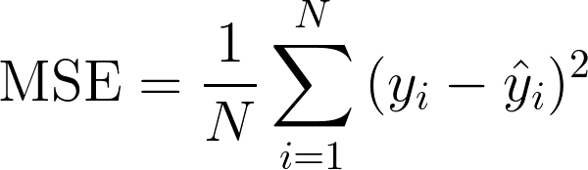
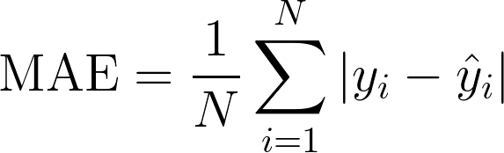
MSE
RMSE
MAE
yᵢ is the actual expected output
ŷᵢ is the model’s prediction.
MSE basically measures average squared error of our predictions. For each point, it calculates square difference between the predictions and the target and then average those values.
In MAE the error is calculated as an average of absolute differences between the target values and the predictions.
The MAE is a linear score which means that all the individual differences are weighted equally in the average.
RMSE is just the square root of MSE.
provides the error rate by the square root of MSE.
Notes:
Notes to presenter:
What was important about this learning experience?
How is it relevant to your course, yourself, or your society or community?
Why is this significant?
This SmartArt allows you add images and text to help outline your process. If a picture is worth a thousand words, then pictures and words should help you communicate this reflection on learning perfectly! You can always click on Insert>SmartArt to change this graphic or select the graphic and click on the Design contextual menu to change the colors.

Slide 17
STATISTIC | CRITERION
R-Squared | Higher the better
Adj R-Squared | Higher the better
F-Statistic | Higher the better
Std. Error | Closer to zero the better
t-statistic | Should be greater 1.96 for p-value to be less than 0.05
AIC | Lower the better
BIC | Lower the better
MAE(Mean Absolute error)
RMSE(Root Mean Square Error) | Lower the better
MSE (Mean squared error) | Lower the better
Min_Max Accuracy => mean(min(actual, predicted)/max(actual, predicted)) | Higher the better
How to know which regression model is best fit for the data?

Slide 18
5. Tools Used
Jupyter notebook is a browser-based platform that supports both programming and document works. The app is used in many styles, for instance, run partial code in the program or run a parallel system with documentation works. These benefits of Jupyter notebook make it widely used in many machine learning communities especially in education.
RStudio is an integrated development environment (IDE) for R, a programming language for statistical computing and graphics. The R language is widely used among statisticians and data miners for developing statistical software and data analysis. Polls, data mining surveys, and studies of scholarly literature databases show substantial increases in popularity.

Slide 19
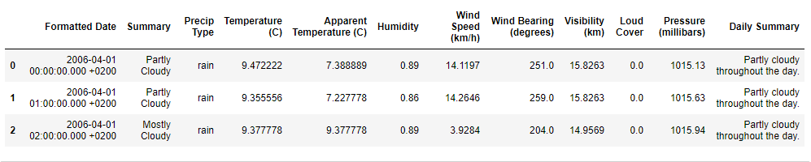
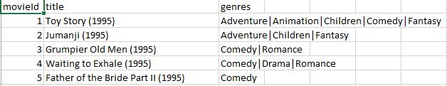
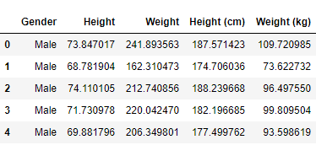
Weather History Dataset
Movielens Dataset
Height-Weight Dataset
Dataset Details

Slide 20

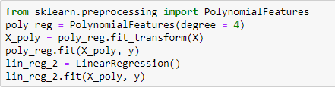
Regression
Code Snippets

Slide 21
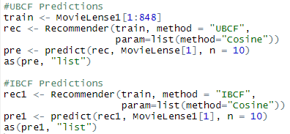
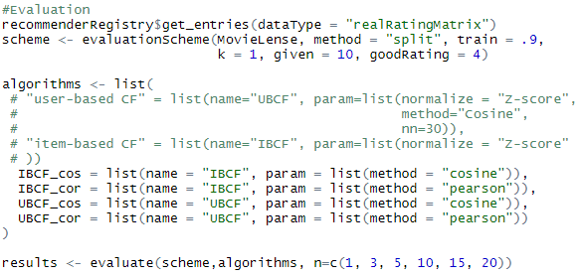
Recommender
Code Snippet

Slide 22








COMPARISONS
for linear regression and polynomial regression
PROBLEM | POLYNOMIAL REGRESSION | LINEAR REGRESSION
Weather Prediction
Height-Weight prediction
Salaries Prediction

Slide 23
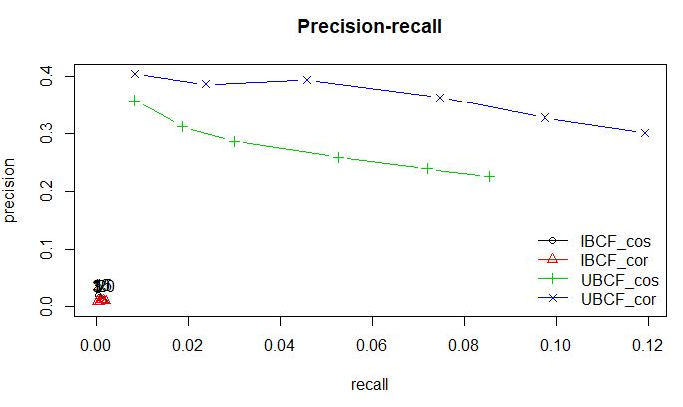
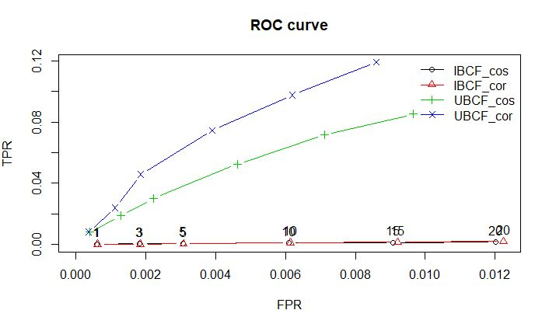
COMPARISONS
for movie recommender system

Slide 24
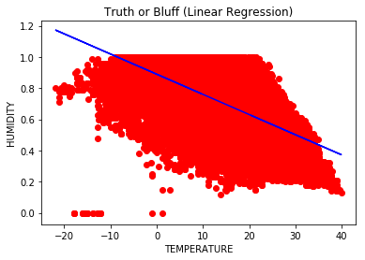
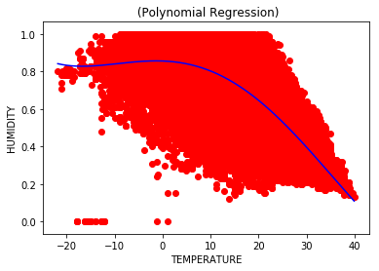
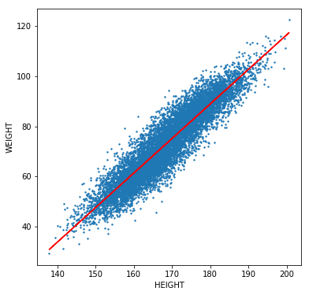
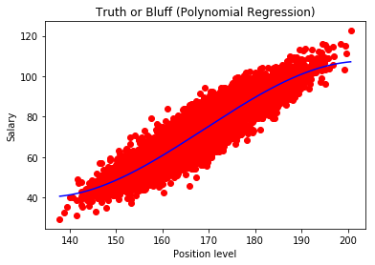
GRAPHS
Linear and Polynomial Regression
Weather Prediction
Salary Prediction

Slide 25
THANK YOU

